Slide 1














An Empirical Study of Artifacts and Security Risks in the Pre-trained Model Supply Chain
Wenxin Jiang Nicholas Synovic Rohan Sethi
Aryan Indarapu (UIUC) Matt Hyatt Taylor R. Schorlemmer
George K. Thiruvathukal James C. Davis
In collaboration with

Slide 2
Contributions
Measure the artifacts in 8 model hubs and depict the PTM supply chain
Threat models and potential risks
Directions to address the security vulnerabilities on model hubs
2
Notes:
We measured the artifacts in 8 model hubs, identified the typical structures, and depicted the PTM supply chain.
We also reviewed existing security defenses and analyzed potential threat models. Our analysis shows that existing defenses are insufficient for ensuring the security of PTMs distributed in model hubs.
We also inform future directions to address the security vulnerabilities.

Slide 3
Background and Motivation
3

Slide 4
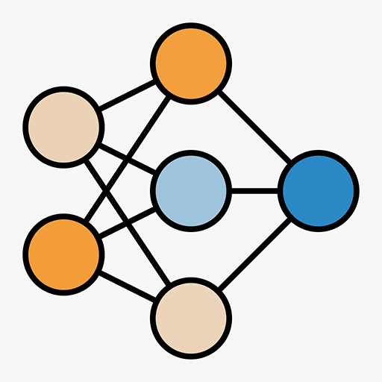
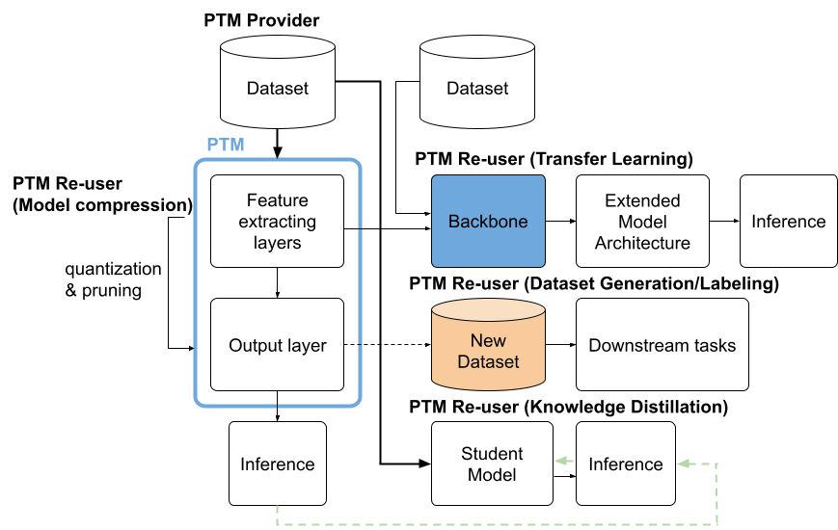
Pre-trained Model Re-use
PTM: Pre-trained deep learning models
→ Same task or novel applications
Han, Xu, et al. "Pre-trained models: Past, present and future." AI Open. 2021.
Zhuang, Fuzhen, et al. "A comprehensive survey on transfer learning." Proceedings of the IEEE, 2020.
4
Notes:
Pre-trained model reuse
Definition: Pre-trained DL models/Neural networks, including model checkpoints, configuration and data pipeline.
A PTM can be used in either the same task or novel applications.
This figure shows different methods for PTM reuse, including model compression, transfer learning, dataset labeling, and knowledge distillation.
Initially, a PTM provider trains a DL model on a dataset to create a model checkpoint. A PTM user can implement one of the methods below to transfer information to the new model.
The new models can be smaller, more manageable, and resource-efficient.
These different reuse methods make the PTM reuse as a kind of software supply chain.

Slide 5
Security Risks on and with PTMs
Security vulnerabilities in software supply chain
Adversarial attacks
Indirectly: data poisoning
Stealing attacks
Directly: backdoor/Trojan attacks, malware injection
Goldblum et al. "Dataset security for machine learning: Data poisoning, backdoor attacks, and defenses." TPAMI. 2022.
Wang et al. "Evilmodel: hiding malware inside of neural network models." ISCC. 2021.
5
Notes:
Security vulnerabilities
Our work build on knowledge from the traditional software supply chain and package registries and determine the characteristics of them in the PTM context
Researchers have described many attacks on PTMs. Let’s take a look at how these attacks map onto the PTM use case diagram.
(click)
Here is that diagram again
First, some attacks directly target PTMs and can either modify the models’ prediction on specific input patterns by backdoor/Trojan attack, or add side-effects by inject malware into the PTMs.
Second, it is possible to attack a model indirectly from its training dataset by data poisoning attacks
Moreover, there can also be stealing attacks. The attackers can steal either the private models used for business products or dataset like private images
.

Slide 6

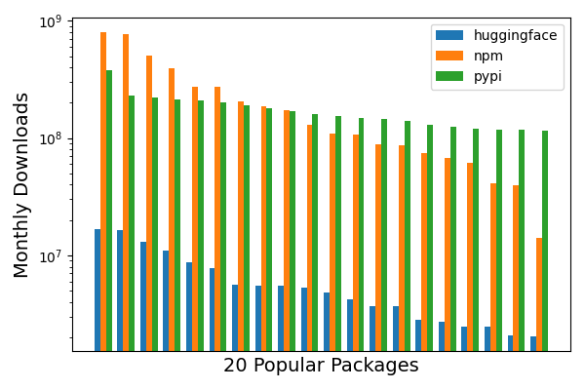
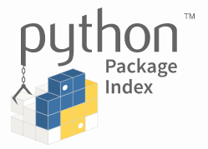

Model Hubs
What is it?
PTMs and datasets organized by problem domain.
Compared to traditional package registries
10,000,000+
6
Notes:
Model hubs:
Collections of Pre-trained Models and datasets organized by problem domain
To the best of our knowledge, the first model hub was introduced in 2018 from Google, which is TensorFlow hub.
Goal: help engineers better reuse these costly artifacts
(click)
Compared to traditional package registries:
HuggingFace is the largest model hub. It mainly provides language models.In August 2022, it had over sixty thousand public PTMs.
(click)
The downloaded rates of HF are comparable to the popular packages in npm and Pypi.
(click) The most popular four PTMs has over 10 million monthly downloads.
It’s also interesting that most of these 20 models are created by researchers from other companies, while the top-29 from npm and pypi are not.
Model hubs function as a research-to-practice pipeline which is different from npm and pypi

Slide 7
Research questions
What is the typical structure of model hubs?
What practices improve security in model hubs?
What are the potential threats in model hubs?
7
Notes:
We know what the attacks are, but the characteristics and practices of secure PTM supply chain have not been studied before,
To characterize the PTM supply chain, we ask the following three questions.
Typical structure: what artifacts are included? How could a model be contributed, distributed, and updated in model hubs?
What are existing security features in different types of model hubs?
What are the threat models and potential risks in different model hubs?

Slide 8
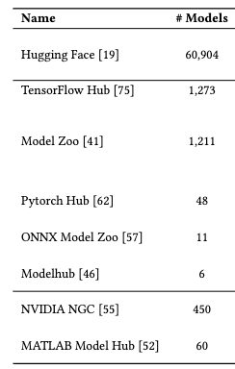
Model Hub Identification
Keywords in major search engine
Selection criteria: definition, website, documentation
Result: 8 model hubs
8
Notes:
Keywords: ML model hub, DL model hub
Selection criteria:
Match our definition of model hub (i.e. a collection of models and datasets organized by problem domain)
Should have a website -> instead of only have github repo
The documentation should be accessible -> analyze
Finally, we got 8 model hubs,
We analyzed the #models, #dataset, and, how the PTMs are contributed and distributed.

Slide 9
Results
9

Slide 10
RQ1: Typical Structure of Model Hubs
Three different types:
Open
← Anyone
Gated
← Approved contributors
Commercial
← Internal engineers
10
Notes:
We identify three different types: open, gated, commercial.
The types are determined by how the PTMs are contributed.
For example, in HuggingFace, anyone can upload and publish a PTM there. For TensorFlow Hub, only those PTMs approved by tensorflow team will be published there. In commercial model hubs, the PTMs are only offered by internal engineers.

Slide 11
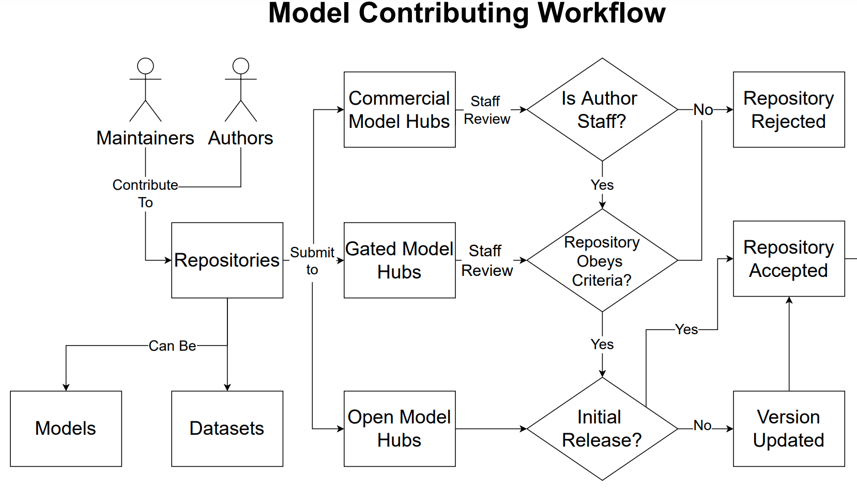


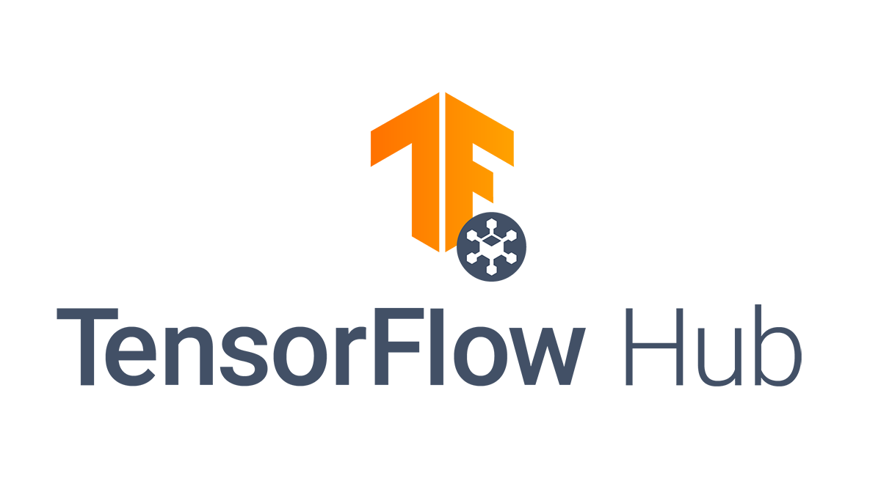

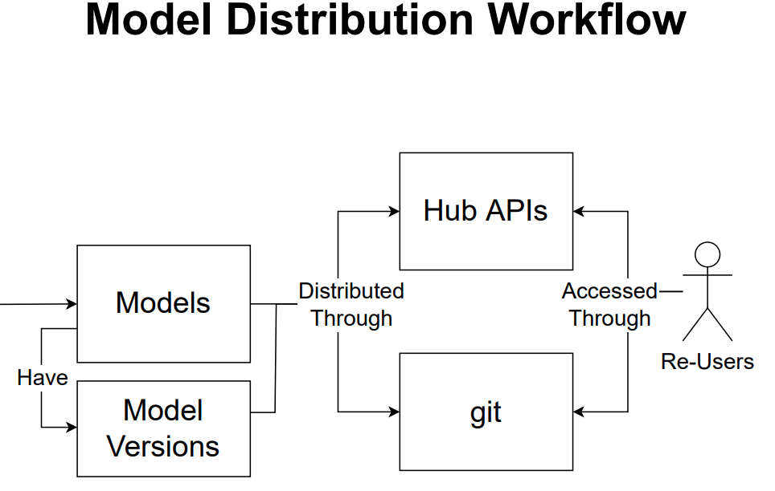
RQ1: Typical Structure of Model Hubs
Model Hubs
. . .
Three types: Open, gated, commercial
Contributing workflow: different
Distribution workflow: similar
11
Notes:
The contributing workflow:
Different types are different
Distribution workflow:
Models are distributed through client libraries, or which is called Hub APIs which are implemented by model hubs, such as HuggingFace.
Or some model hubs directly distribute repositories hosted on a cloud version control system such as GitHub.
Putting together, we have the contributing workflow, distribution workflow, and model versioning. The re-users here can also be the model authors or maintainers. This generate a supply chain kind of thing. We call this figure as the PTM supply chain!

Slide 12
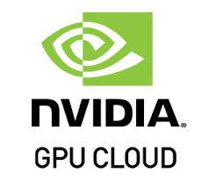




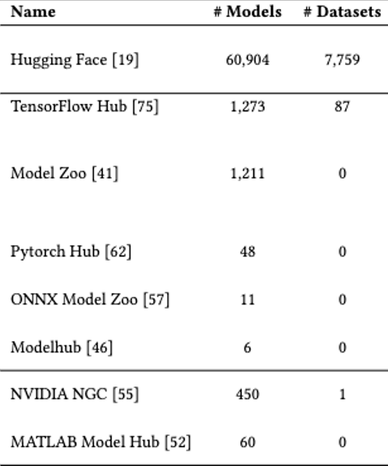
RQ2: Security Practices
Accessibility-security tradeoff
App stores
2.87M 1.96M
Open → Existing security features cannot cover all risks.
Permission model
Organization verification
Commit signing
Commercial & Gated → More secure due to controlled access
12
Notes:
To better understand the security features and identify potential problems, we studied different model hubs.
(click)
Here are some examples for each model hub type
(click)
Here are the #models and #datasets in these model hubs
(click)
For open model hubs, here we mean (HuggingFace specifically):
We measured three security features: user permission model, organization verification, and commit signing. More details can be found in our paper.
We found that these security features are not widely used and thus can present potential risks and vulnerabilities for the reusers.
(click)
For commercial and gated model hubs:
Due to the controlled access of these model hubs, they restrict access to a trusted set of users, there is less risk that a change to a model is malicious.
(click) During our study, we found that there exist an accessibility-security tradeoff in these model hubs.
(click) Analogous to the app stores, the less accessible the model hubs are, the less risks the contributors and reusers will have.
*** Bonus:
Permission model: HF has two types of accounts, personal account and organizational account. User permissions for organizational accounts are assigned globally so that users will have the same permissions to all the repositories hosted under that organization.
Organization verification:
This is an optional feature that organizations can opt into to provide a verification badge on their accounts.
The purpose of verification is to prevent other organizations from squatting on well known companies or organizations.
However, we found that many organizations have not opted into this optional feature. An organization can provide a link to a website and GitHub account without having to go through HF manual verification.
Commit signing: The purpose is to validate that a commit originated from a specific individual on a specific machine.

Slide 13
RQ3: Potential Threats
Threat Models:
Insider: maintainers, contributors → weight poisoning, backdoor, data manipulation
Outsider: users → model and data stealing
Insider
. . .
Insider attacks
Insider attacks
Outsider attacks
Outsider
attacks
Outsider
13
Notes:
Threat Models
An insider attacker profile is one that exists within the model hub organization themselves.
(click)
E.g. maintainers and contributors which are part of the contributing workflow.
(click)
All types of model hubs open the gate for weight poisoning attacks, backdoor attacks, and data manipulation when an insider is in play.
(click)
Outsider attacker profiles are derived from the model hub users. Which are part of the distributing workflow
(click)
For an open model hub, these attackers can cause damage by maliciously changing data within specific artifacts to affect users and the ecosystem.
For commercial and gated model hubs, the outsider attackers are users who do not have more than a “read-only” access to the models. An outsider in such case can perform a stealing attack, where they could rebuild the data and model from the PTM "black-box".

Slide 14
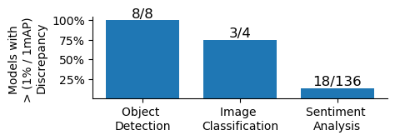
RQ3: Potential Threats
Maintainers’ reach graph
1 maintainer → 1000+ PTMs
→ Model hub is vulnerable
Model discrepancies
Inaccurate documentation exist
→ Users’ awareness and the detectability of PTM attacks
14
Notes:
Potential Risks:
Maintainers’ reach graph
The figure shows that how many repos are maintained by each maintainer.
The maintainers’ misbehavior can become an insider attack and do harm to the PTM supply chain.
(click)
This figure shows a small number of maintainers have access to a large number of repositories. By compromising one of these accounts, attackers could influence hundreds of models and thus do harm to the PTM supply chain too.
Model discrepancies:
Model discrepancies : Documented and actual performance of PTMs may be different when users run the models
These discrepancies can be caused by either insider or outsider attackers. When a model’s documentation is thorough and accurate, model discrepancies are more likely to indicate potential PTM attacks. However, the lack of proper documentation prevents users from adequately assessing the models they use.
(click)
We identified the existence of inaccurate documentation in HF, as shown in the figure.
There are totally 53 object detection models, 26 image classification models, and 160 sentiment analysis models, of which only 8, 4, and 136 provided auditable claims.
Some of the models have more than 5% discrepancy, even when they were from major technology companies.
(click)
Why: The presence of performance discrepancies could either decrease the users’ awareness or the detectability of PTM attacks.
***
To summarize our finding for RQ3:
Insider and outsider attackers can both exist in the PTM supply chain, but perform different attacks.
We proved the possibility of potential risks by analyzing the model discrepancies and maintainers’ reach graph

Slide 15
Discussion and Implications
Differences from traditional software supply chain
Versioning
→ Empirical study
Traditional software supply chain → PTM supply chain
Security risks
→ Automated tool
Model audit → PTM behavior
Model scanning → PTM attacks
15
Notes:
Comparing to traditional software supply chain, the PTM supply chain has different characteristics, in terms of the nature of software versioning and security risks
Versioning:
The requirements for time and computational resources in the PTM training mean it’s hard to regularly update the PTM versions.
it’s more difficult to quantify the change between different versions because differences between the training dataset, methods, or hardware configurations can dramatically impact the quality of the resulting model.
And the current practices in the PTM supply chain lack auditability of these changes.
(click)
Empirical study:
The security characteristics of PTM supply chain remain under-discovered. We call for expanding our knowledge of traditional supply chain management to encompass DL software supply chains, including studies on dependencies, maintainers, and security issues.
Security risks:
PTM attacks are highly variable and have significant impacts if they are deployed in safety-critical systems such as autonomous vehicles.
The manifestation of PTM attacks can be different from traditional attacks. Thus traditional scanning tools are not enough in PTM context.
(click)
Automated tools:
Model audit: checking of different PTM behavior is a necessary approach to validate existing PTMs.
Model scanning: specific integrated scanning tools for PTMs are needed for iproving the security of model hubs.

Slide 16


Conclusions
We want to know more about PTM supply chain!
We need more to ensure its security!
Contact: jiang784@purdue.edu
Website: wenxin-jiang.github.io
https://github.com/PurdueDualityLab/SCORED22-PTMSupplyChain
Notes:
In conclusion, we did the first study on model hubs and show that the PTM supply chain is an essential part of DL software supply chain. We examined 8 model hubs, including three different types and summarized the PTM supply chain.
Our analysis shows that the existing defenses are not enough for ensuring the security of PTMs distributed through model hubs
That's all for my talk!
Here are my contact information and our artifact. Thanks for your attention!

Slide 17
Bonus slides
17

Slide 18
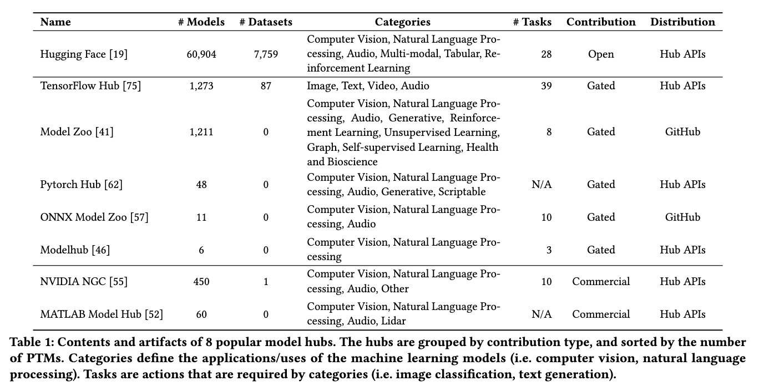
Contents and Artifacts of 8 Model Hubs.
18
Notes:
We highlight future directions for empirical study and automated tools.
Empirical study:
The security characteristics of PTM supply chain remain under-discovered. We call for expanding our knowledge of traditional supply chain management to encompass DL software supply chains.
Automated tools:
Model audit: checking of different PTM behavior is a necessary approach to validate existing PTMs.
Model scanning: specific integrated scanning tools for PTMs are needed for iproving the security of model hubs.

Slide 19
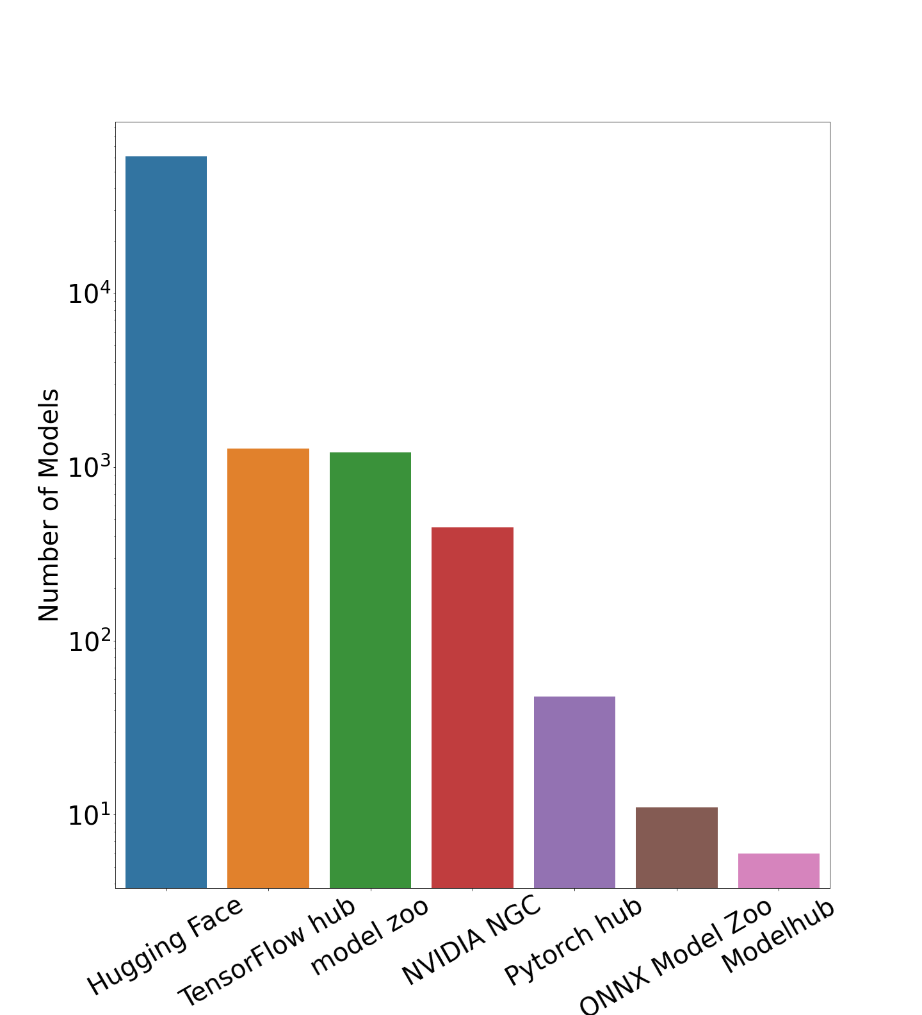
Number of PTMs in Each Model Hub
19
Notes:
We highlight future directions for empirical study and automated tools.
Empirical study:
The security characteristics of PTM supply chain remain under-discovered. We call for expanding our knowledge of traditional supply chain management to encompass DL software supply chains.
Automated tools:
Model audit: checking of different PTM behavior is a necessary approach to validate existing PTMs.
Model scanning: specific integrated scanning tools for PTMs are needed for iproving the security of model hubs.

Slide 20
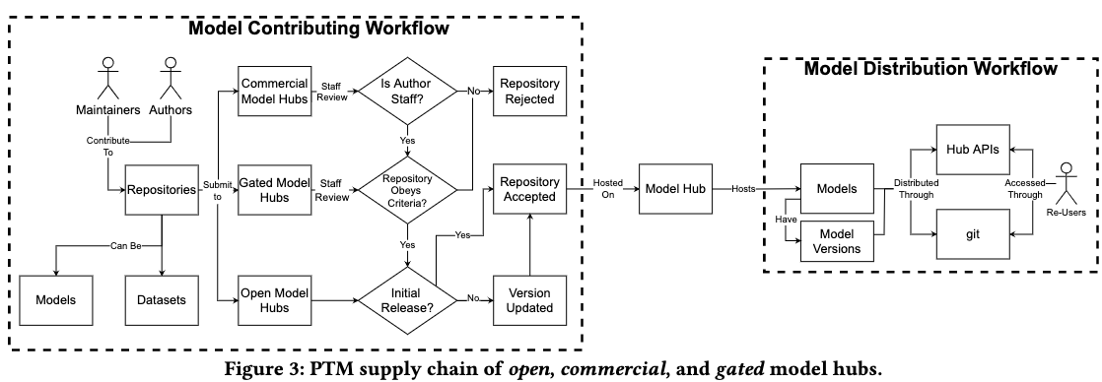
PTM Supply Chain
20
Notes:
We highlight future directions for empirical study and automated tools.
Empirical study:
The security characteristics of PTM supply chain remain under-discovered. We call for expanding our knowledge of traditional supply chain management to encompass DL software supply chains.
Automated tools:
Model audit: checking of different PTM behavior is a necessary approach to validate existing PTMs.
Model scanning: specific integrated scanning tools for PTMs are needed for iproving the security of model hubs.

